Slide 1

INFOSYS SPRINGBOARD INTERNSHIP 5.0
Voice-Based Patient Call System
By:- Keshav Gupta Batch:- 3
Mentor:- Shilpie

Slide 2

Voice-Based Patient Call System
The Voice-Based Patient Call System improves hospital communication by enabling patients to express their needs naturally using voice. The AI processes and prioritizes these requests and sends them to nurses in real time.

Slide 3
Problem Statement
Inefficient Communication
Nurse Overburden
Traditional call systems are often slow and unreliable, leading to delays in patient care.
Nurses are often overwhelmed with calls, making it difficult to prioritize urgent needs.
Hospitals rely on outdated patient call systems, causing delays in critical care. Nurses often struggle to prioritize multiple patient requests, leading to inefficient workflows and slower emergency responses.

Slide 4

Project Objective
Seamless Communication
Prioritization
Enable direct voice-based communication between patients and nurses.
Prioritize patient requests based on urgency and severity.
Efficiency
Streamline workflows and reduce response times for patient needs.

Slide 5

Technology Stack
Azure OpenAI
Speech Services
Powering intelligent voice assistants for patient interaction.
Processing and transcribing patient requests with high accuracy.
Admin Panel
Natural Language Processing
Understanding the context and intent
behind patient requests.
Web-based dashboard for management.

Slide 6





System Architecture
Patient Voice Input
Speech Recognition
Patients speak their requests directly to the AI assistant.
Speech Services converts voice to text for analysis.
Prioritization Engine
Nurse Notification
NLP determines urgency and prioritizes requests.
Nurses receive alerts via the mobile app.

Slide 7
Feature and Functionalities
1
Voice Recognition
Natural language processing for accurate understanding of requests.
2
Request Prioritization
AI-driven system prioritizes urgent needs for timely response.
3
Nurse Communication
Real-time alerts via mobile app for swift action.
4
User Management
Admin panel manages users, assigns roles, and monitors performance.
5
Data Analytics
System collects data for insights into patient needs and system performance.

Slide 8
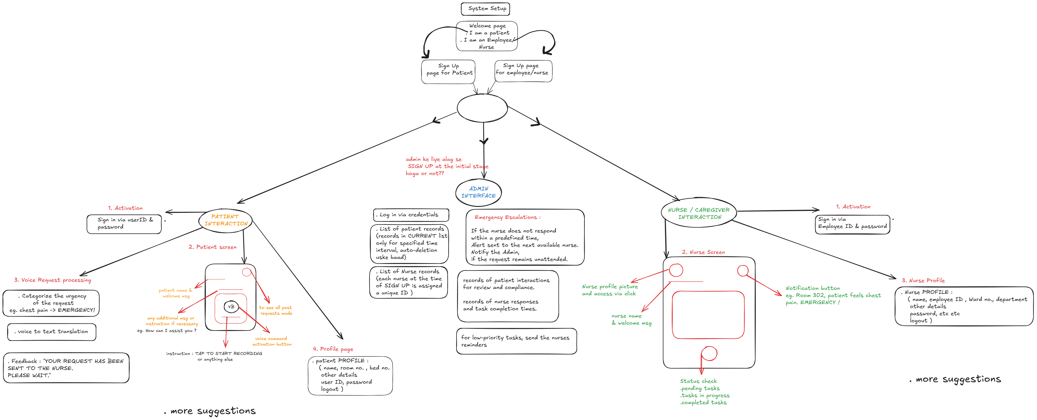
USERFLOW

Slide 9





Module Overview
AI Assistants
Intelligent agents powered by Azure OpenAI for patient interaction.
Speech & Prioritization
Module responsible for speech recognition and request prioritization.
Nurse App
Mobile app for nurses to receive and manage patient requests.
Admin Panel
Web-based interface for user management, monitoring, and data analysis.
Deployment
Implementation and integration of the system within the hospital infrastructure.

Slide 10



Expected Outcomes
Improved Patient Satisfaction
1
Enhanced communication and faster response times.
Increased Nurse Efficiency
2
Streamlined workflows and reduced workload.
Enhanced Hospital Operations
3
Improved patient care and overall operational efficiency.

Slide 11

Conclusion
The Voice-Based Patient Call System represents a significant advancement in patient care, leveraging AI technology to improve communication, efficiency, and patient satisfaction.

